Slide 1

LUA PROGRAMMING LANGUAGE
Davide Perticone
FLC assignments A.A. 2020/2021

Slide 2
Table of contents
History of Lua
Some uses of Lua
Basics
Variables
Tables
Functions
Closures
Coroutines
Array
Matrices
Sets
Linked lists
Metamethods
Running examples:
LoopExample.lua
FuncClose.lua
Coroutines.lua
Metatables.lua

Slide 3
HISTORY OF LUA
Started as in-house project in 1993 by Roberto Ierusalimschy, Luiz Henrique de Figueiredo, and Waldemar Celes.
Lua is designed, implemented, and maintained by a team at PUC-Rio, the Pontifical Catholic University of Rio de Janeiro in Brazil.
Designed from the beginning to be a software that can be integrated with the code written in C
It does not try to do what C can already do but aims at offering what C is not good:
Good distance from hardware
Dynamic data structures
Ease of testing and debugging

Slide 4
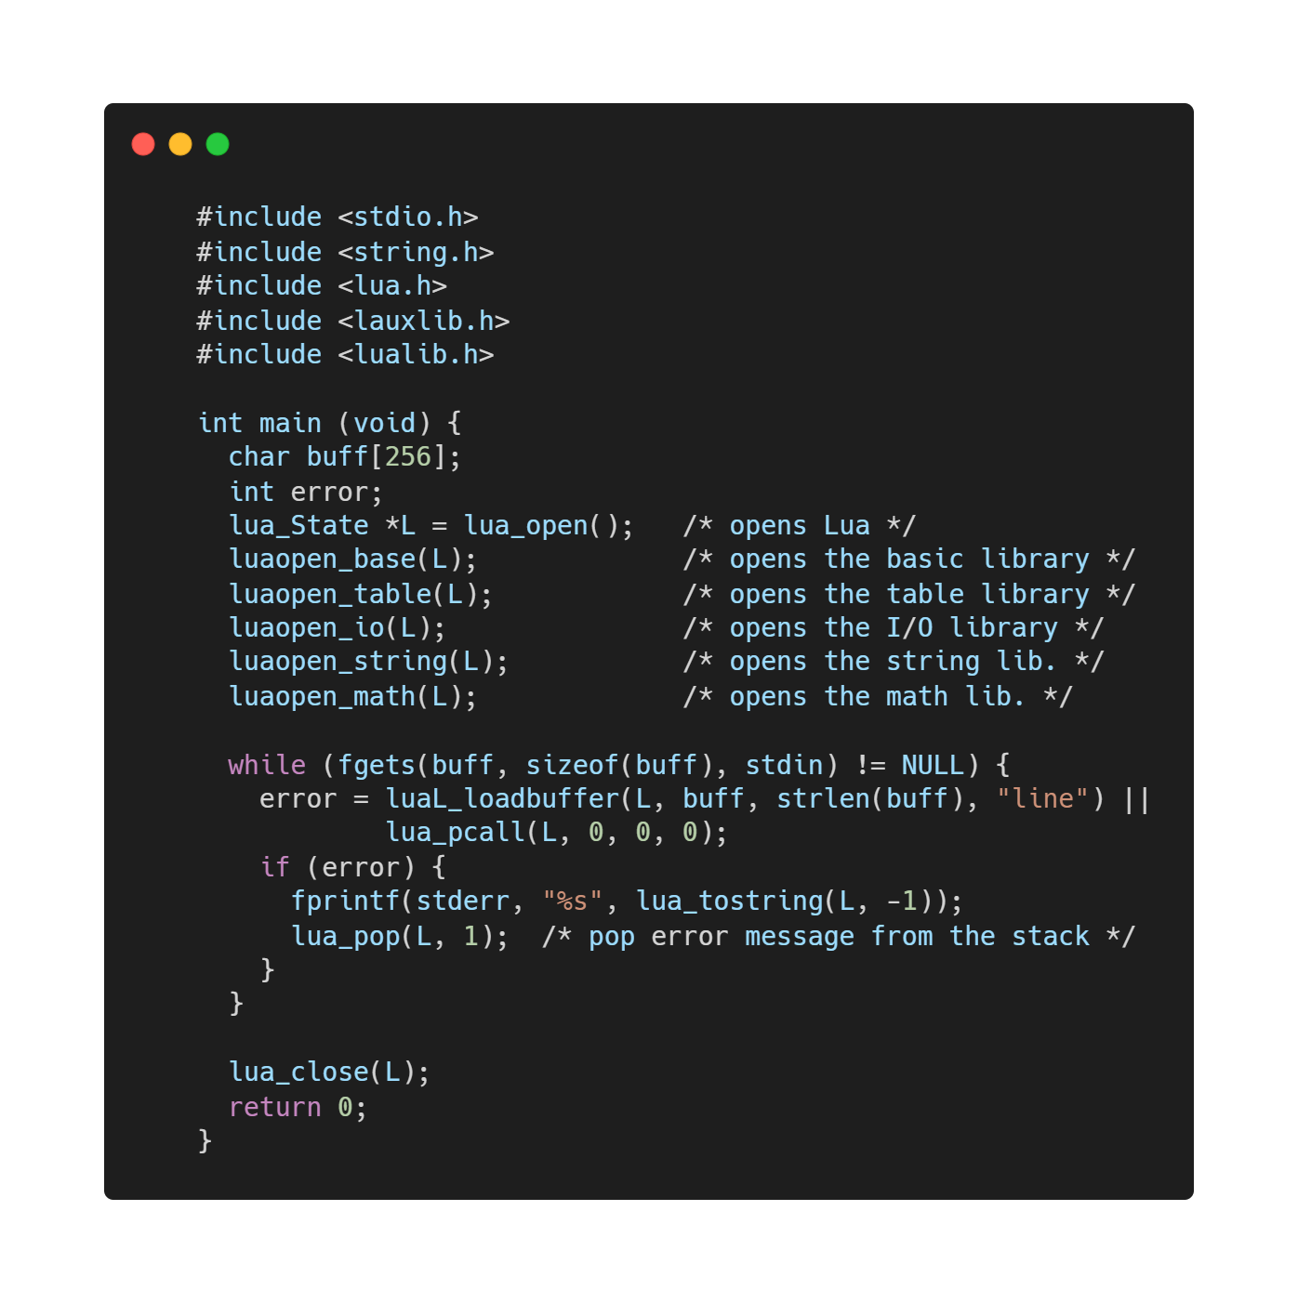
Lua integration in C

Slide 5
Some Uses of Lua:
Game Programming (CryEngine, Angry Birds, World of Warcraft…)
Scripting in Standalone Applications (Adobe’s Photoshop Lightroom)
Scripting in Web
Extensions and add-ons for databases like MySQL Proxy and
MySQL WorkBench
Security systems like Intrusion Detection System.

Slide 6
Info on Lua
What does it mean Lua? Is it a noun?
"Lua" (pronounced LOO-ah) means "Moon" in Portuguese.
Is Lua fast?
Lua has a deserved reputation for performance. To claim to be "as fast as Lua" is an aspiration of other scripting languages.
Is Lua compiled or interpreted?
Lua programs are not interpreted directly from the textual Lua file, but are compiled into Lua bytecode, which is then run on the Lua virtual machine. The compilation process is typically invisible to the user and is performed during run-time. Then, Lua bytecode is interpreted. For the end-user, Lua can be considered as an interpreted language, but looking closely, it is compiled (and then interpreted).

Slide 7
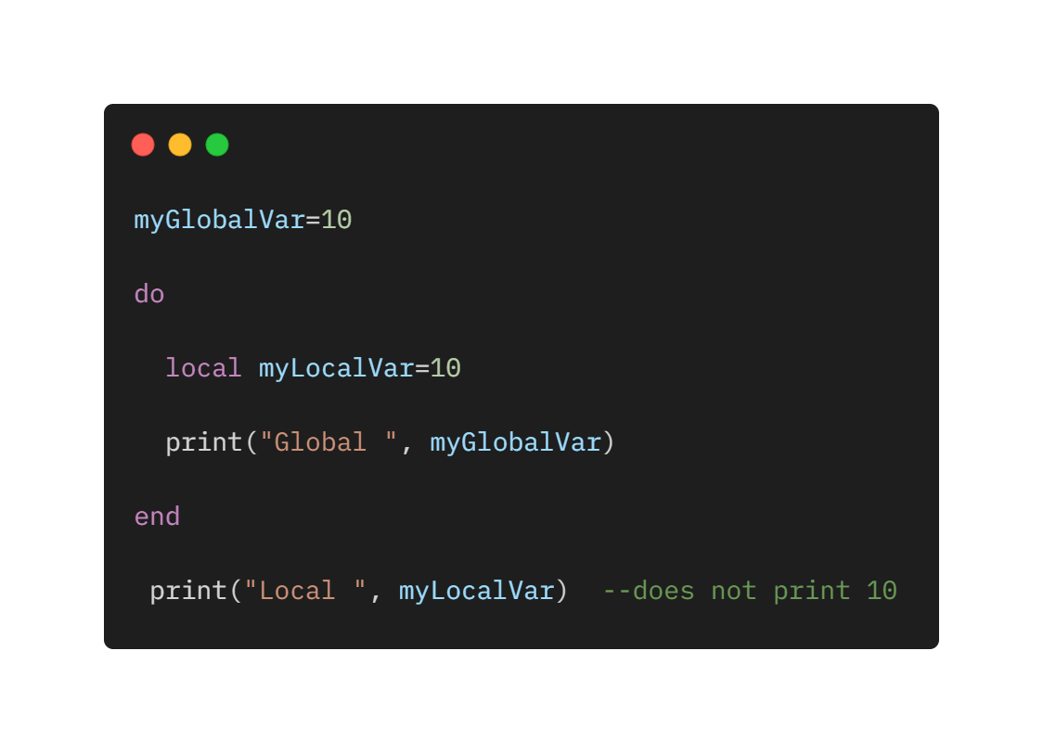
Variables
Global variables: all variables are considered global unless explicitly declared as a local.
Local variables: when the type is specified as local for a variable then its scope is limited with the functions inside their scope.

Slide 8
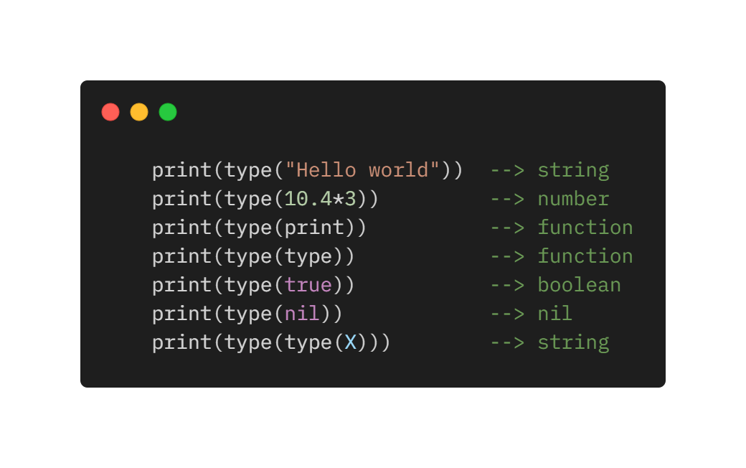
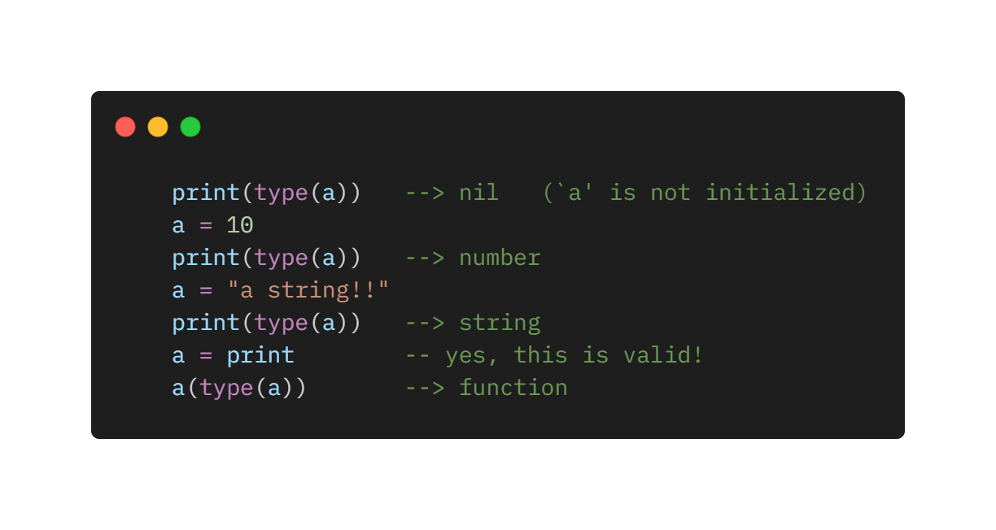
Types and Values
Lua is a dynamically typed language. There are no type definitions in the language; each value carries its own type.
Eight basic types in Lua: nil, boolean, number, string, userdata, function, thread, and table.
Variables have no predefined types; any variable may contain values of any type.
Notice the last two lines: Functions are first-class values in Lua; so, we can manipulate them like any other value.

Slide 9
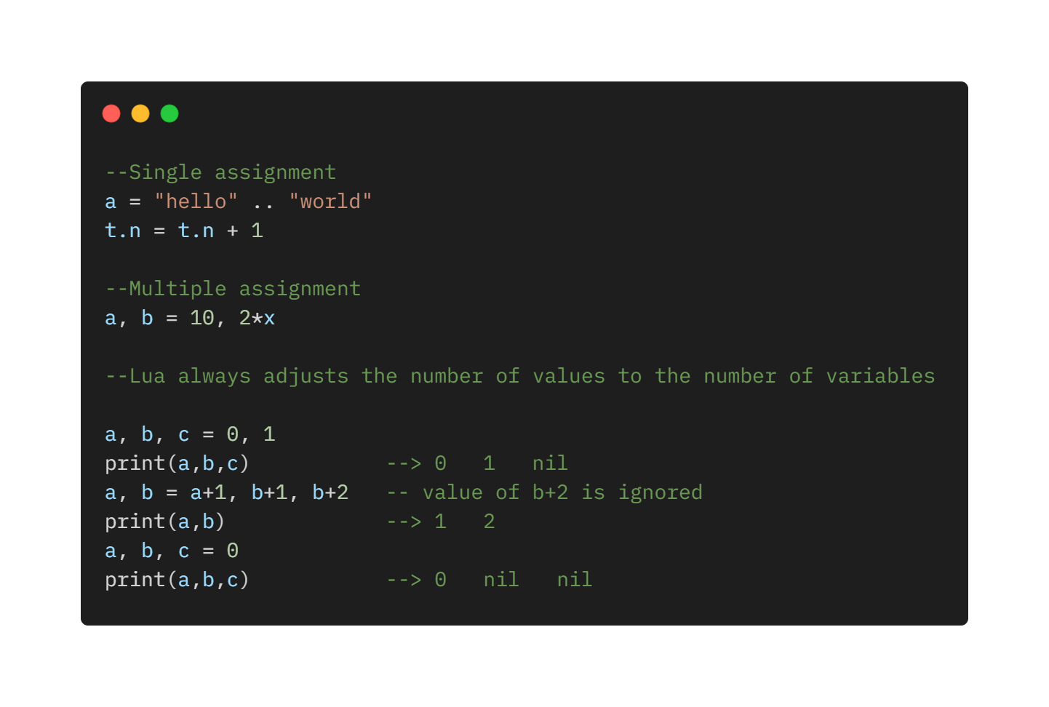
Assignment

Slide 10
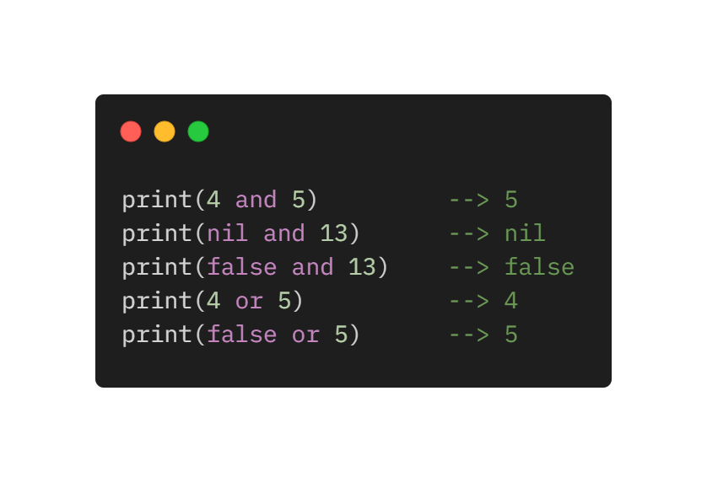
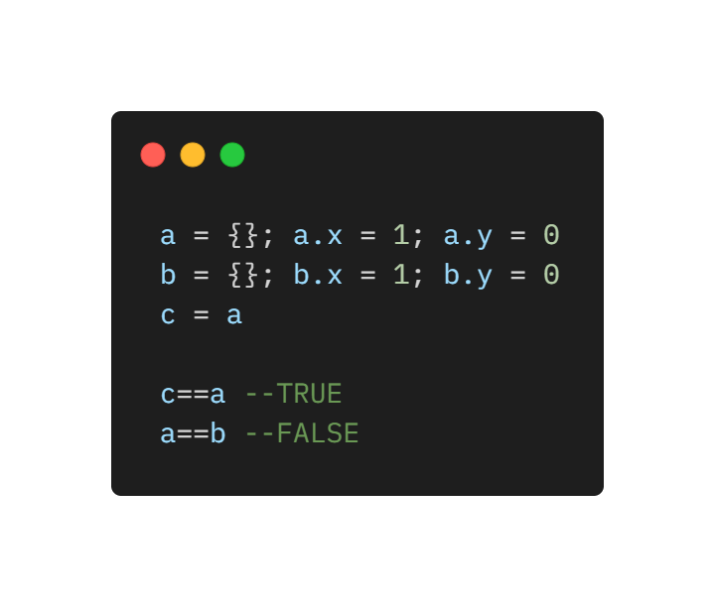
Expressions
Arithmetic operations: `+´ (addition), `-´ (subtraction), `*´ (multiplication), `/´ (division), and the unary “-” (negation), ^ (just syntax to maintain simplicity, library gives meaning)
Relational Operators: < > <= >= == ~= All these operators always result in true or false
Lua compares tables, userdata, and functions by reference, that is, two such values are considered equal only if they are the very same object.
The logical operators are and, or, and not. Like control structures, all logical operators consider false and nil as false and anything else as true
The operator and returns its first argument if it is false; otherwise, it returns its second argument. The operator or returns its first argument if it is not false; otherwise, it returns its second argument

Slide 11
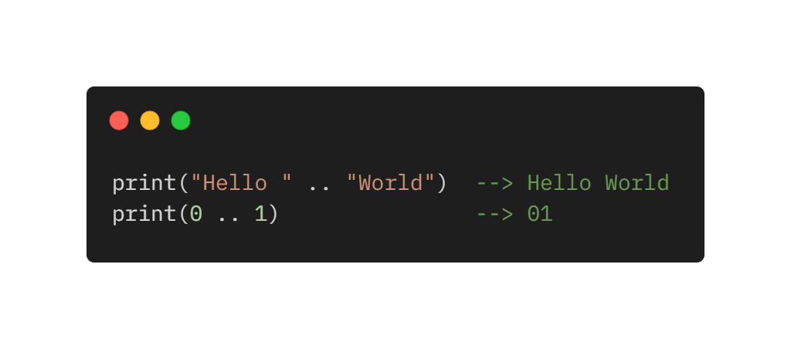
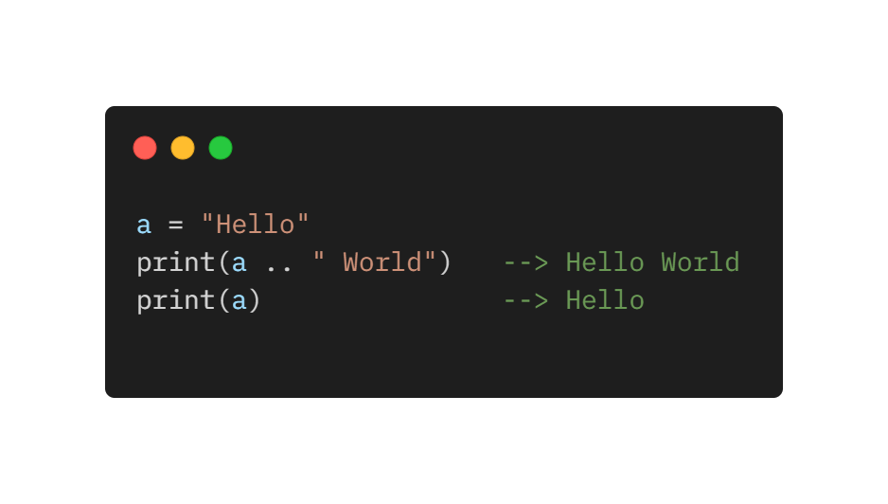
Expressions cont.
Lua denotes the string concatenation operator by ".." (two dots). If any of its operands is a number, Lua converts that number to a string.
Strings in Lua are immutable values. The concatenation operator always creates a new string, without any modification to its operands:

Slide 12
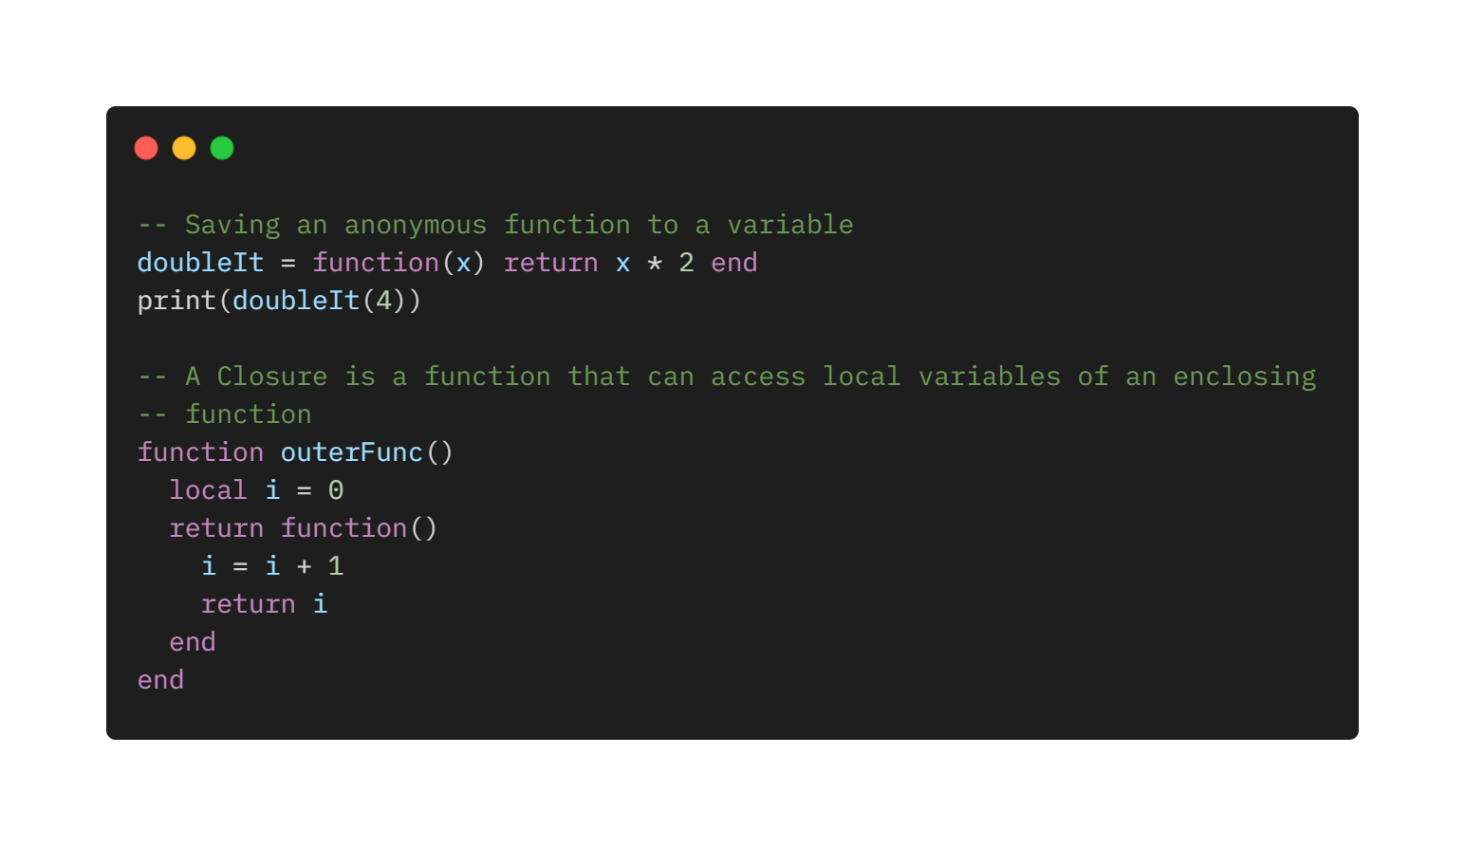
Functions
Functions are first-class values
Can be stored in variables
Passed as arguments (to other function)
Returned as results.
Can be declared anywhere in the code

Slide 13
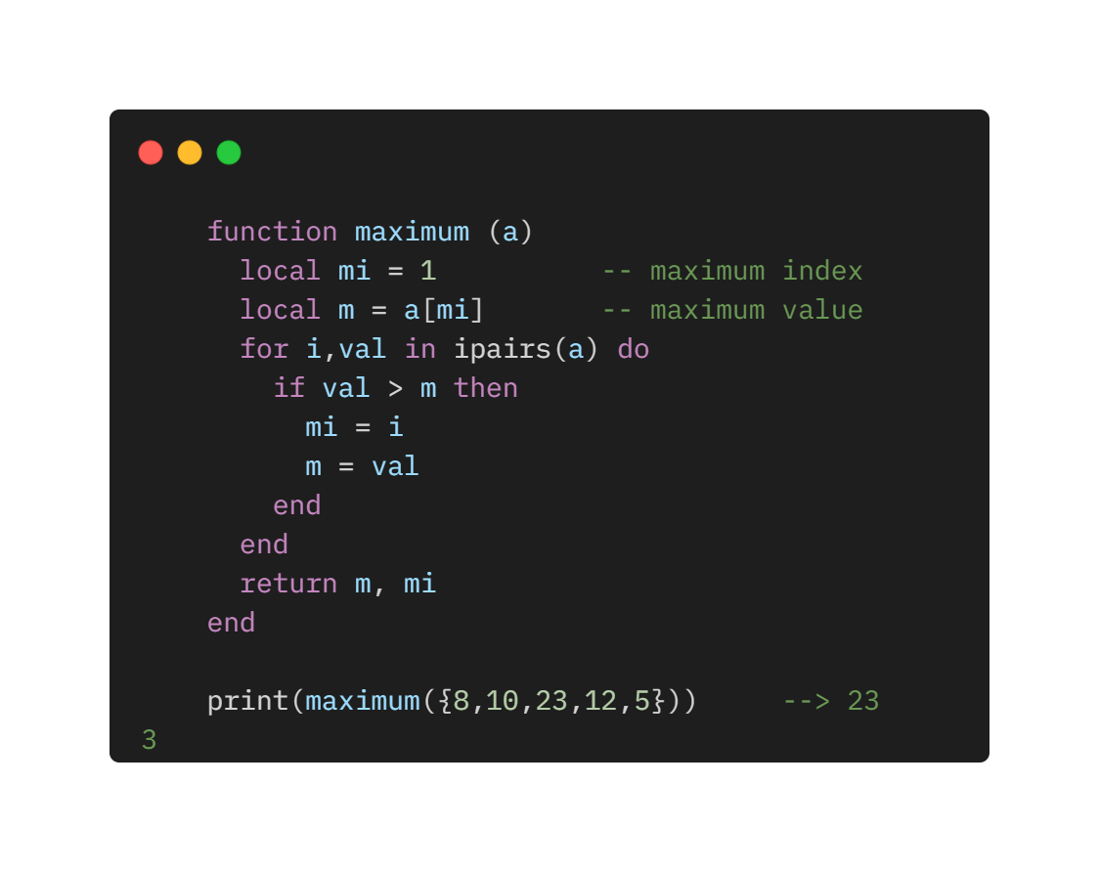
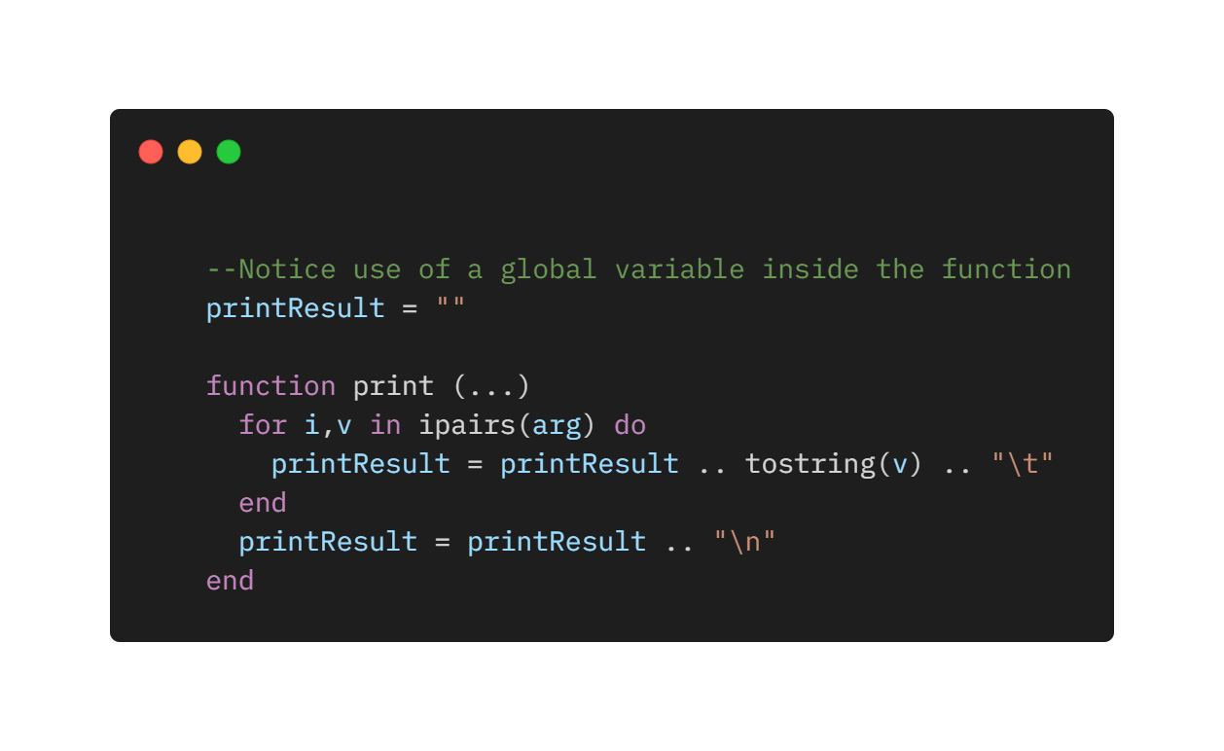
Multiple Results - Variable Number of arguments
Functions written in Lua also can return multiple results, by listing them all after the return keyword.
Three dots (…) in parameter list indicate variable number or arguments
When function called, parameters are collected and access through hidden table “arg”,

Slide 14
About Functions
Functions are first class values:
Same rights as conventional values (strings, numbers).
Can be stored in (global and local) variables and tables.
Can be passed as arguments and retuned by other functions.
They have proper lexical scoping
A function can access variables of its enclosing function (see closures, next slide).

Slide 15
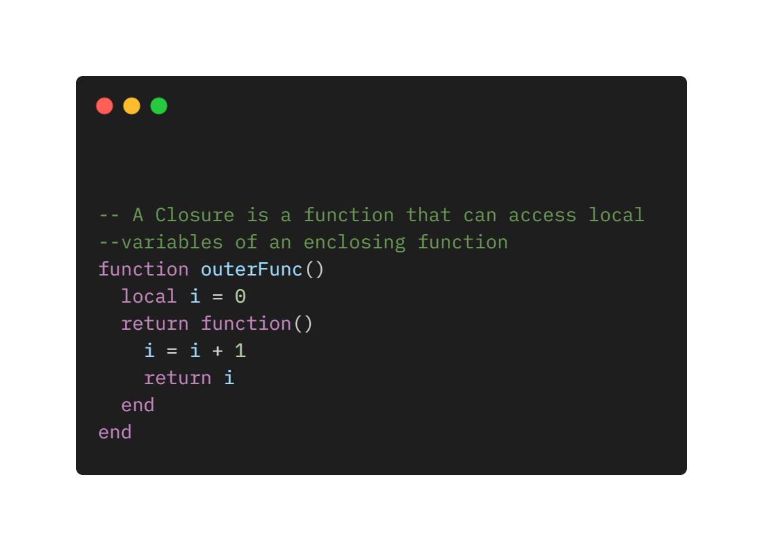
Closures
Lexical scoping allows enclosing function to access parent function.
This features allows to declare closures:
Constructs where an inner function (returned as result) can access the parent local variables even after parent function has finished execution
A closure construction typically involves two functions: the closure itself; and a factory, the function that creates the closure
Example next slide

Slide 16
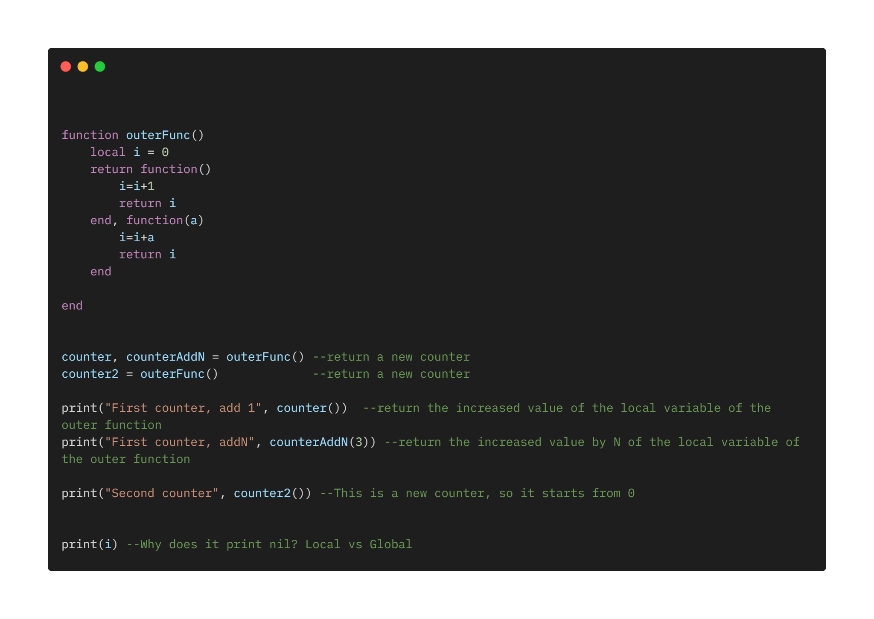
Running example FuncClos.lua

Slide 17
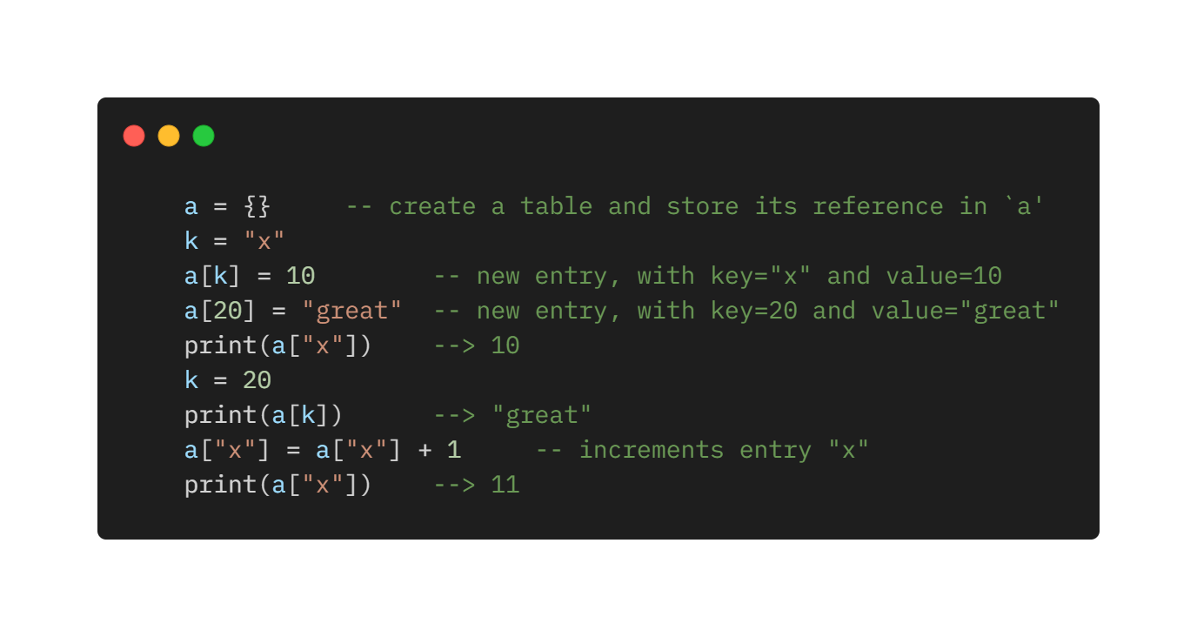
Tables
The table type implements associative arrays. An associative array is an array that can be indexed not only with numbers, but also with strings or any other value of the language, except nil.
Tables are the main (in fact, the only) data structuring mechanism in Lua, and a powerful one.
They are used to:
Represent ordinary arrays
Symbol tables
Sets
Records
Queues
Many other data structures.
Tables in Lua are neither values nor variables; they are objects. Same concept of Java

Slide 18
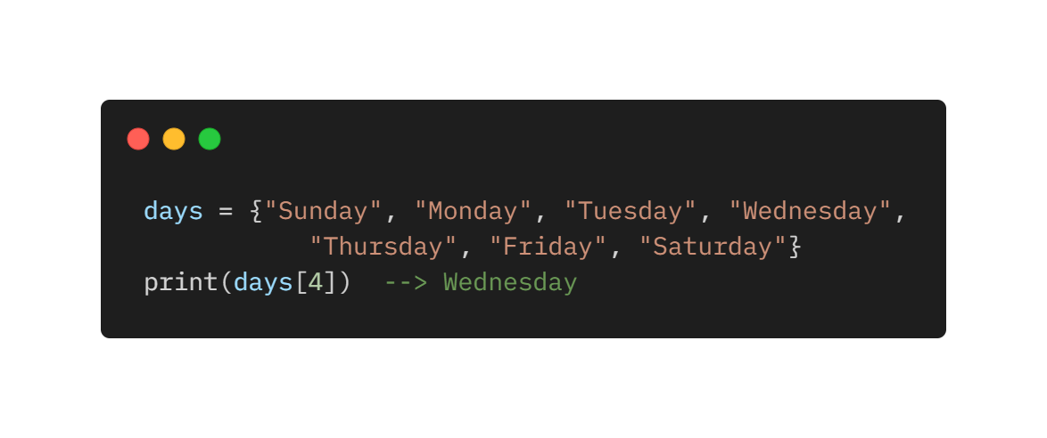
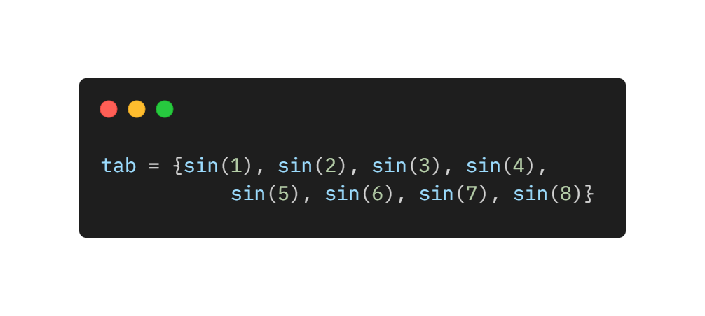
Constructors
Constructors are expressions that create and initialize tables. They are a distinctive feature of Lua and one of its most useful and versatile mechanisms. The constructor initializes days[1] with “Sunday”
Constructors do not need to use only constant expressions.

Slide 19
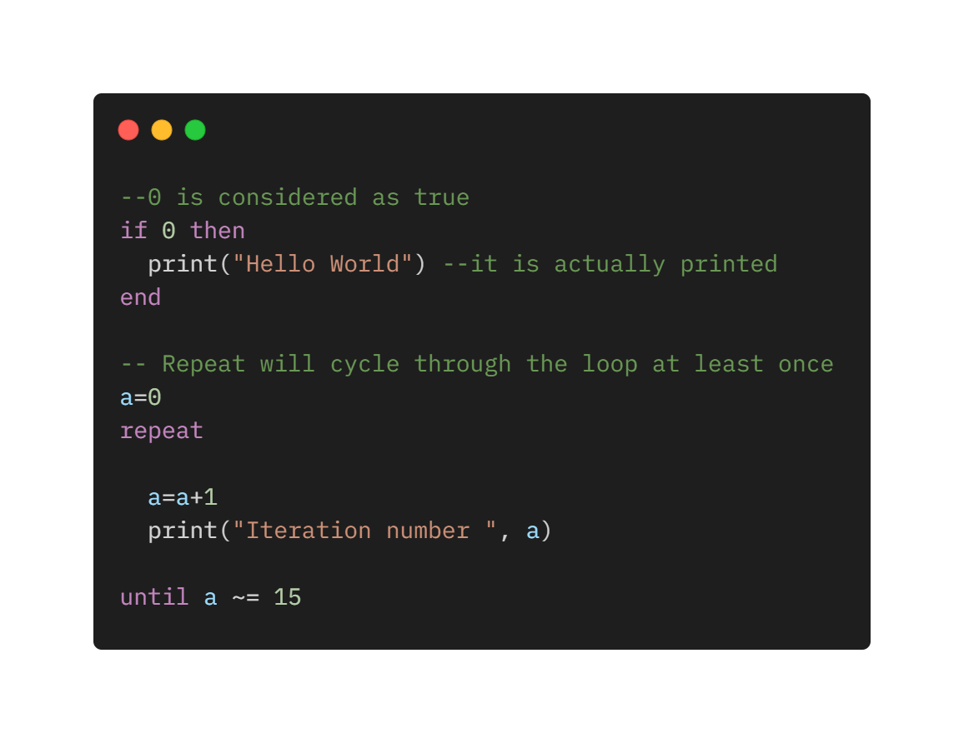
Control Structures
If else elsif – conditional structures
while, repeat until, for – iteration structures
All control structures have an explicit terminator: end terminates the if, for and while structures;
until terminates the repeat structure.
The condition expression of a control structure may result in any value. Lua treats as true all values different from false and nil.

Slide 20
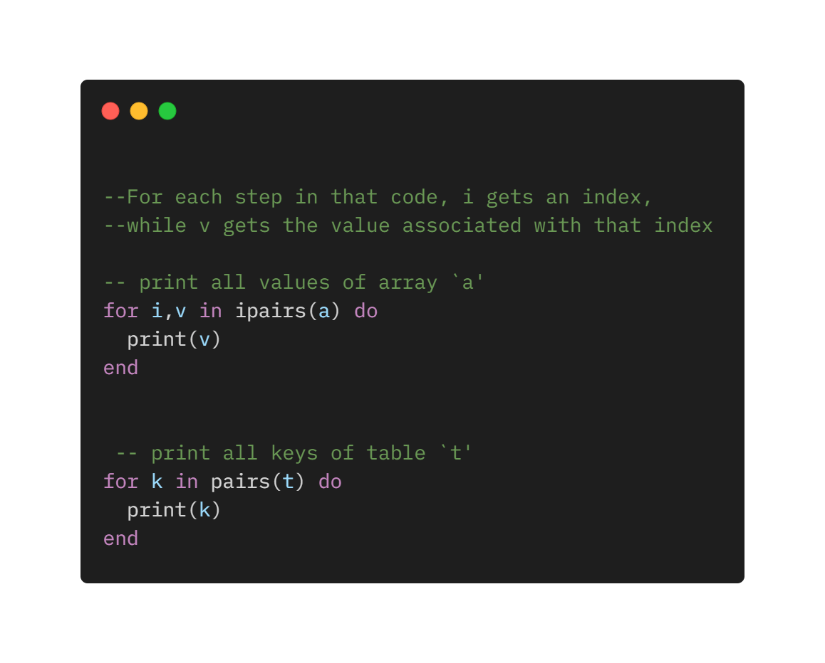
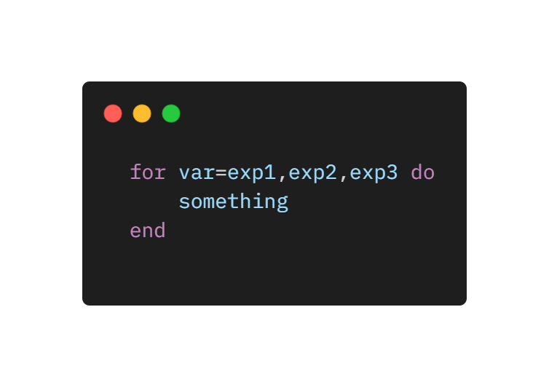
Numeric for – Generic for
The for statement has two variants: the numeric for and the generic for.
A numeric for has the following syntax:
for var=exp1,exp2,exp3 do
something
end
That loop will execute something for each value of var from exp1 to exp2, using exp3 as the step to increment var. This third expression is optional; when absent, Lua assumes one as the step value.
The generic for loop allows you to traverse all values returned by an iterator function.

Slide 21
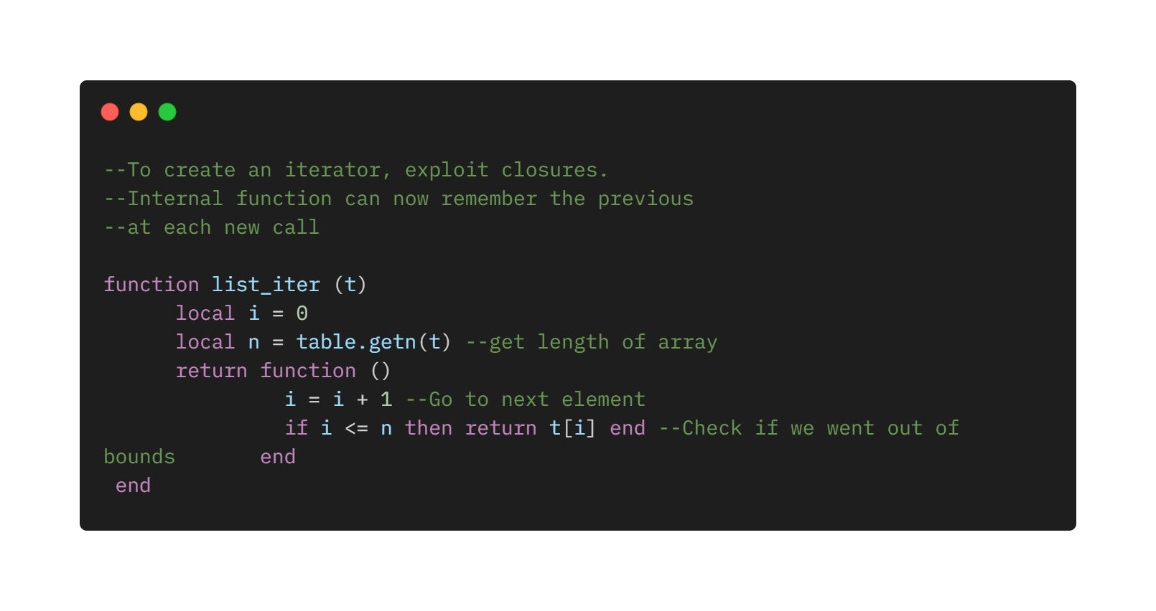
Iterators
An iterator is any construction that allows you to iterate over the elements of a collection. Lua represents iterators by functions: Each time we call that function, it returns a "next" element from the collection.

Slide 22
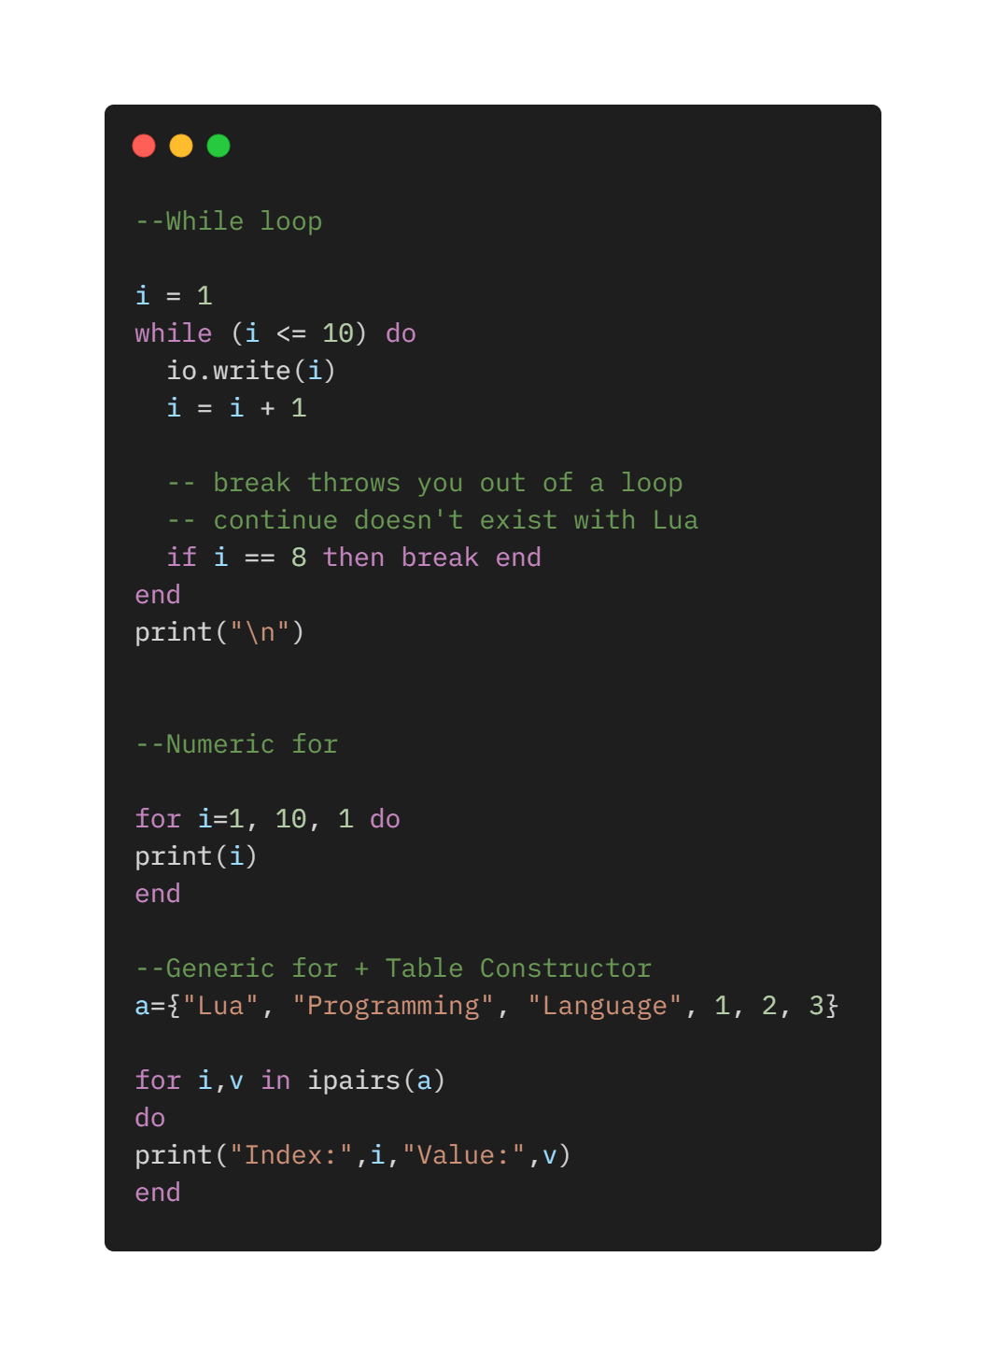
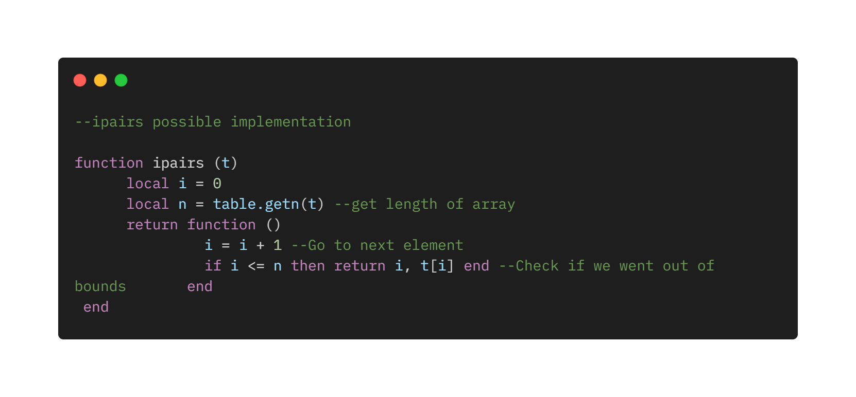
Running example LoopExample.lua

Slide 23
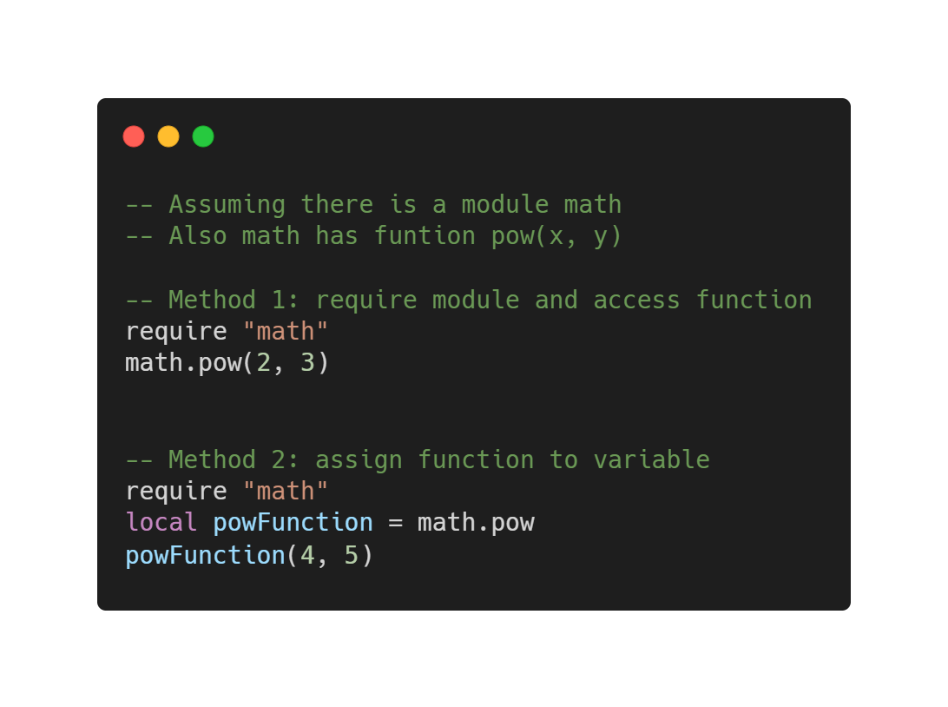
The require Function
Lua offers a higher-level function to load and run libraries, called require. First require searches for the file in a path; require controls whether a file has already been run to avoid duplicating the work.

Slide 24
Coroutines
Lua offers all its coroutine functions packed in the coroutine table.
The create function creates new coroutines. It has a single argument, a function with the code that the coroutine will run. It returns a value of type thread, which represents the new coroutine.
Often, the argument to create is an anonymous function.
A coroutine can be in one of three different states: suspended, running, and dead. Upon creation, it starts in the suspended state.
Coroutines are like threads except that they can't run in parallel.
Coroutines are non-preemptive. They cannot be stopped from outside.

Slide 25
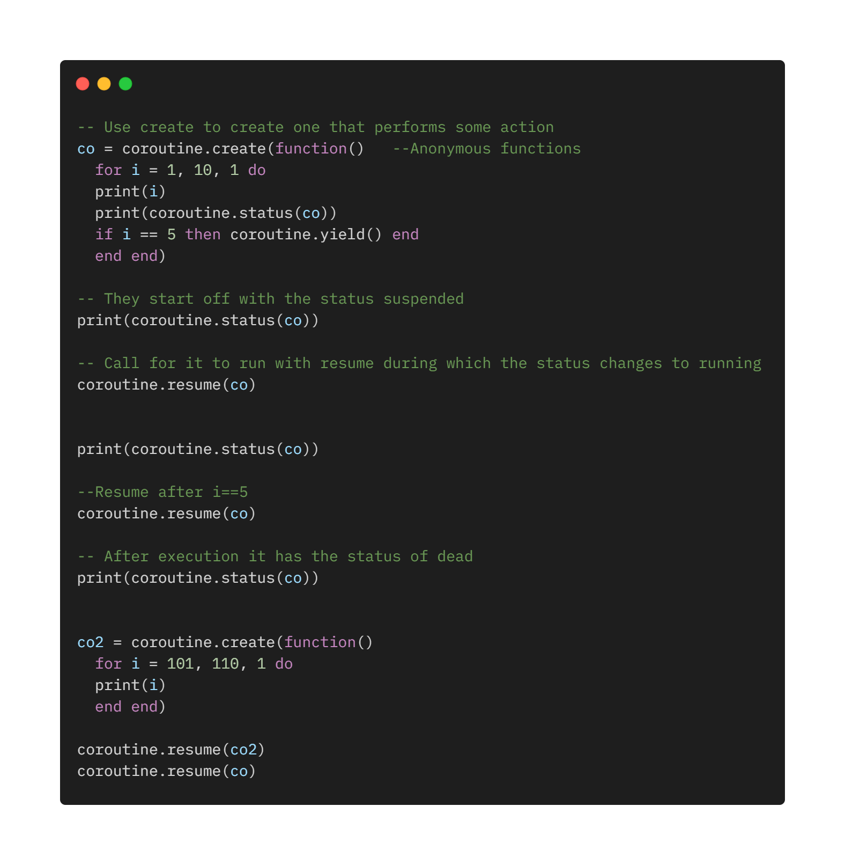
Running Example Coroutines.lua

Slide 26
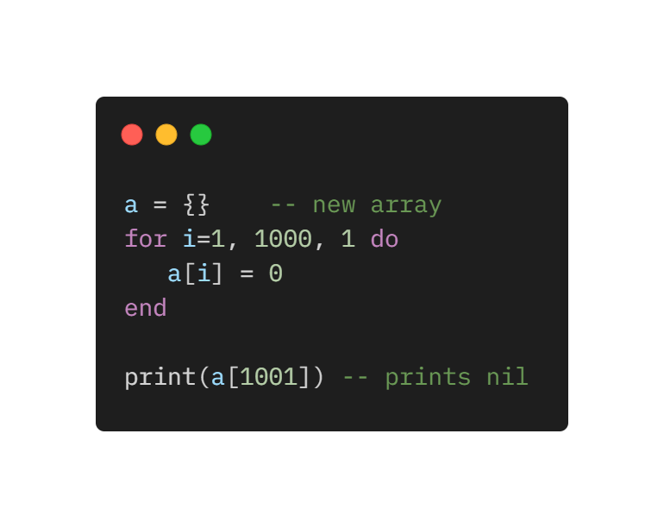
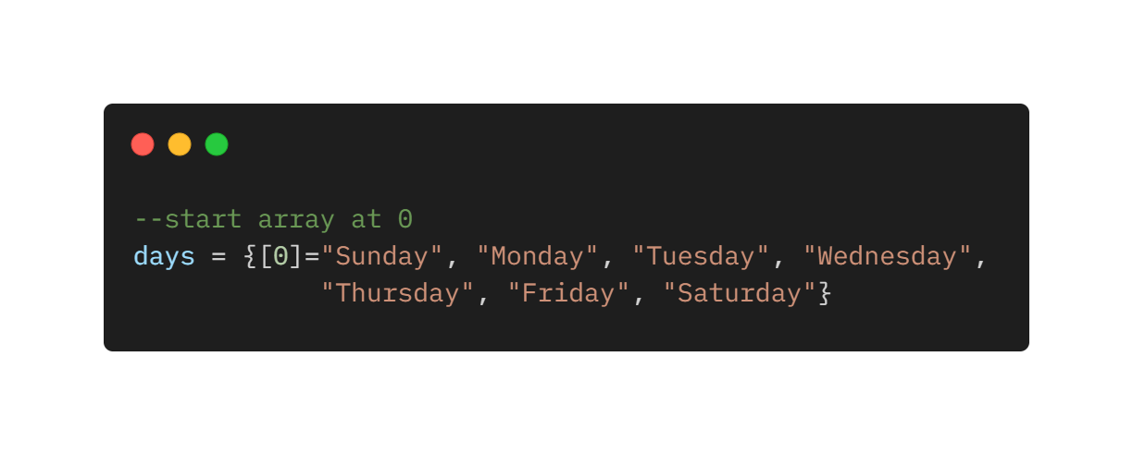
Arrays
Lua implements arrays simply by indexing tables with integers.
Therefore, arrays do not have a fixed size, but grow as needed.
When initializing an array, the size is defined indirectly.
Arrays start always from 1 instead of 0 if not otherwise specified.
The Lua libraries adhere to this convention. It is possible to use library functions
directly If arrays start from 1.

Slide 27
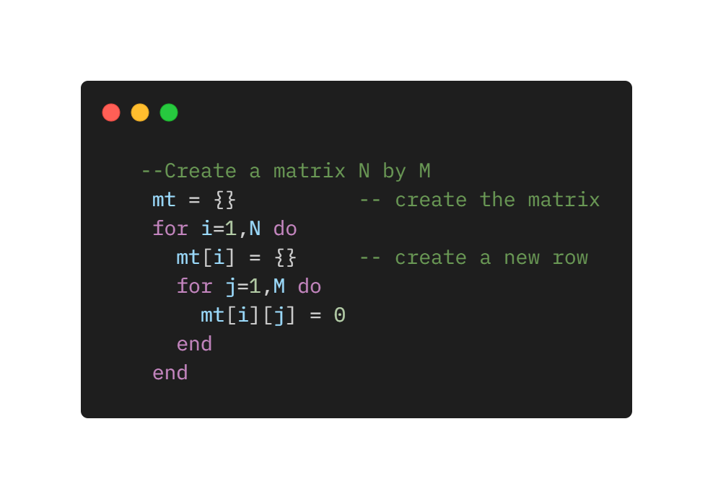
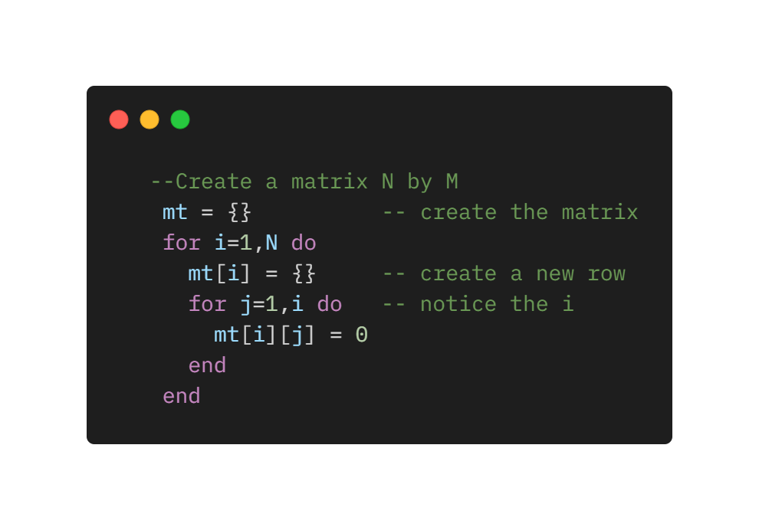
Matrices
There are no direct methods to construct matrices in Lua. The easiest way is to use arrays of arrays, that is a table wherein each element is another table.
On the one hand, this is certainly more verbose than simply declaring a matrix, as done in C or Pascal. On the other hand, that gives more flexibility. For instance, it is possible to create a triangular matrix.
In this way, the triangular matrix saves half the space of a normal matrix.

Slide 28
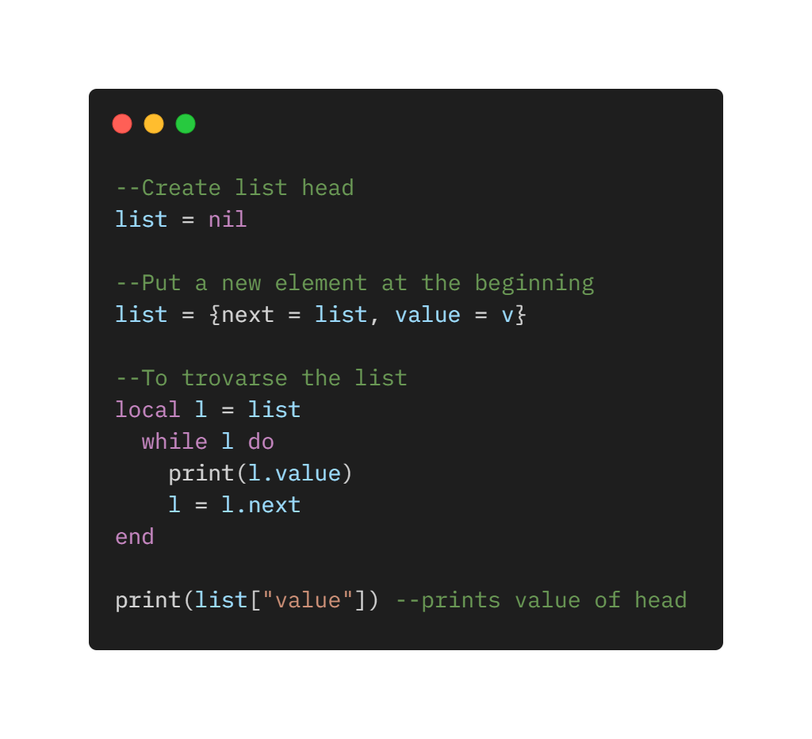
Linked Lists
Because tables are dynamic entities, it is easy to implement linked lists in Lua. Each node is represented by a table and links are simply table fields that contain references to other tables.
It is very easy to implement them, and the value can of course be another table, complex as needed.

Slide 29
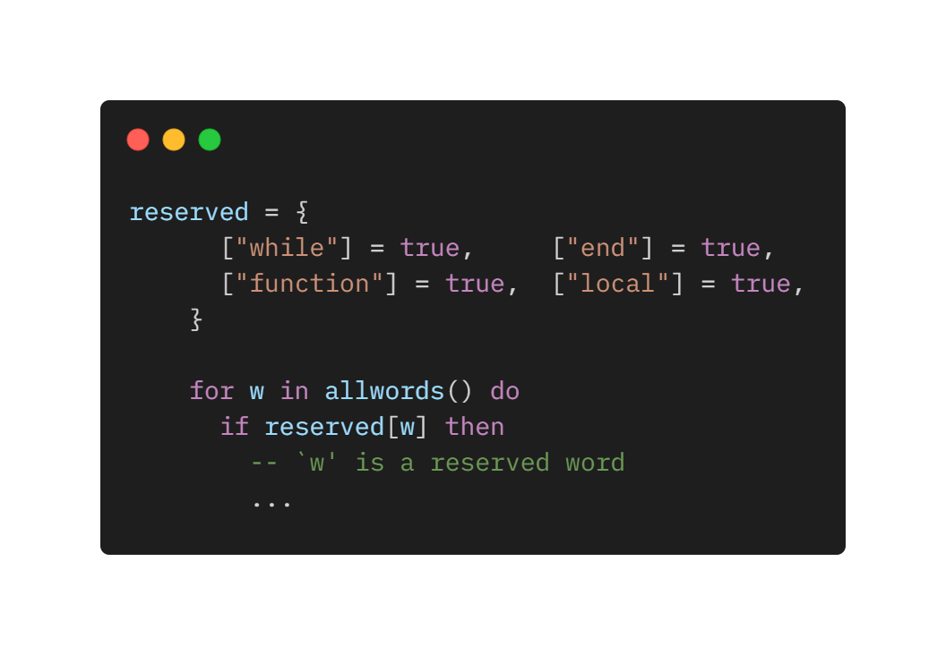
Sets
In Lua, an efficient and simple way to represent such sets is to put the set elements as indices in a table.
The corresponding value is set to true
Instead of searching the table for a given element, just index the table and test whether the result is nil or not.
If nil, the element is not in the set, if true, it is.

Slide 30
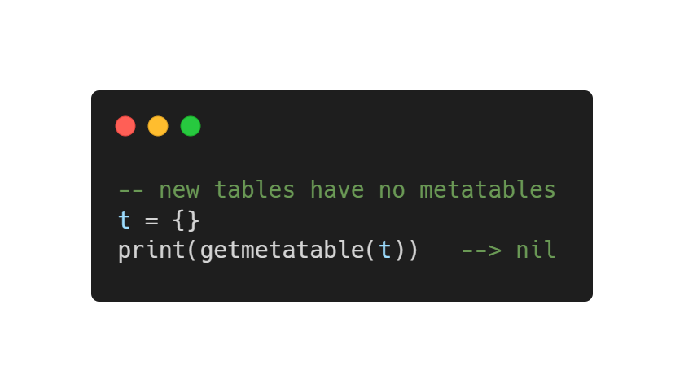
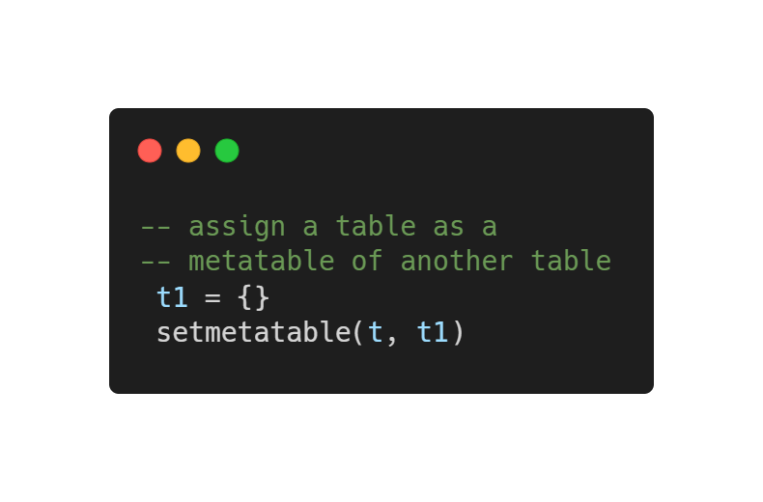
Metamethods
A limited set of perations can be performed on tables:
add key-value pairs
check the value associated with a key
Traverse all key-value pairs
What about adding tables, compare tables, divide tables and so on?
It is not possible natively, unless…metatables are used.
Similar to overloading operators for classes in C++.
Metatables allow to change the behaviour of a table. If we want to add two tables following a specific logic, it is possible to define a metatable for one of the two tables (or both) containing a metamethod called __add.
If Lua finds __add when trying to add two tables, the corresponding metamethod is called to compute the sum. The order is decided based on the operands (if __add defined by first operand, use it, if not, use __add of second, if neither have __add Lua raises an error.
Each table in Lua may have its own metatable. By default, newly created table have no metatables.
Any table can be the metatable of any other table

Slide 31
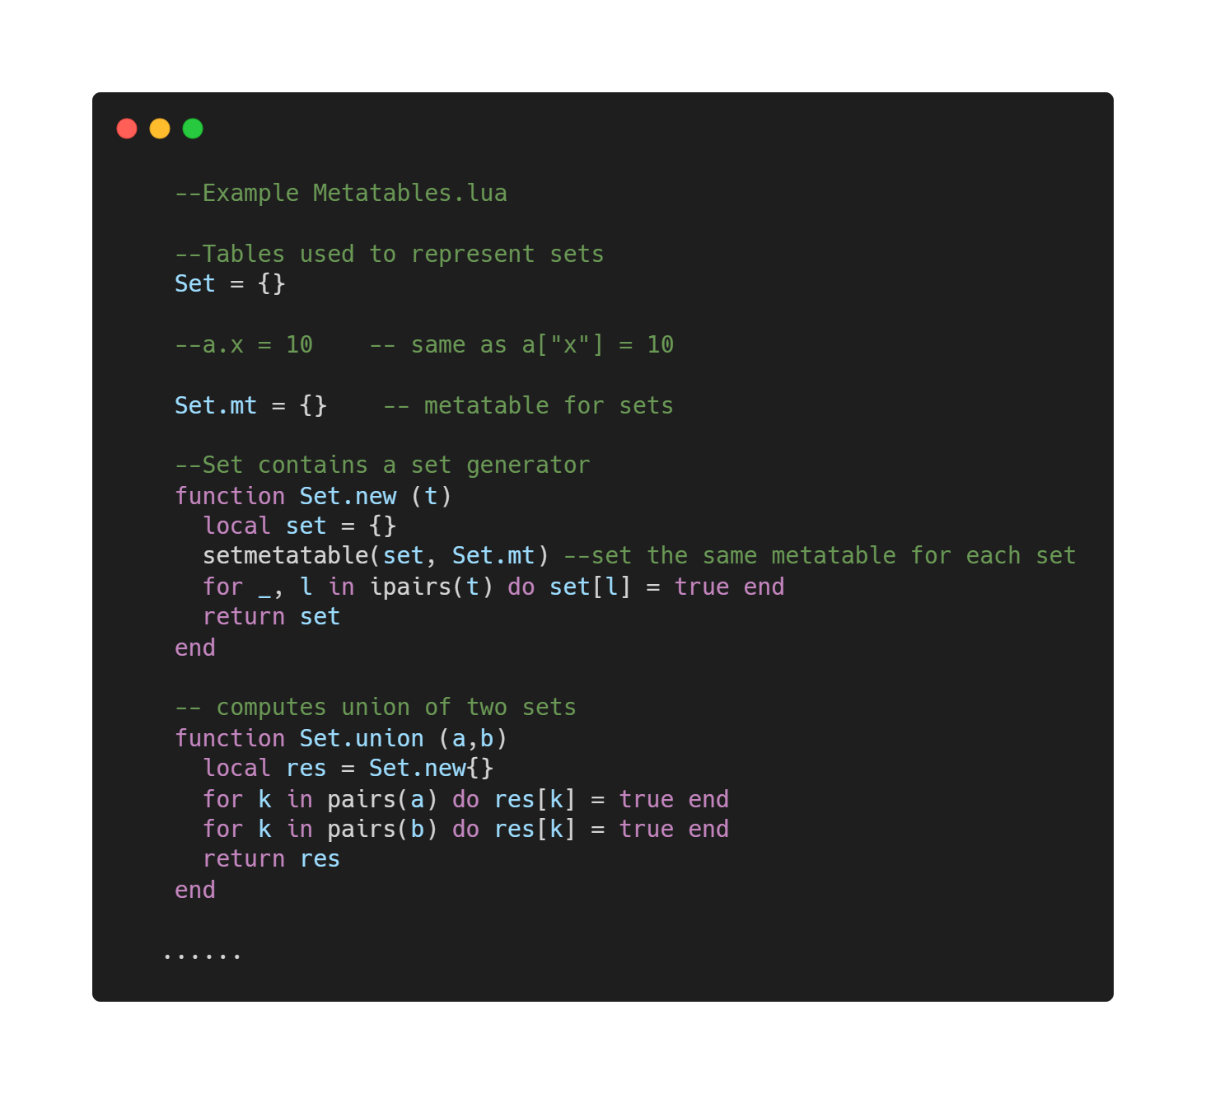
Running example – Arithmetic metamethods

Slide 32
What I implemented

Slide 35
Instructions:
Declaration and inline initialization local and global variables
Assignment to local or global variables
return statement
function call
expression

Slide 37
References
Programming in Lua
by Roberto Ierusalimschy Lua.org, December 2003 ISBN 8590379817

